Slide 1
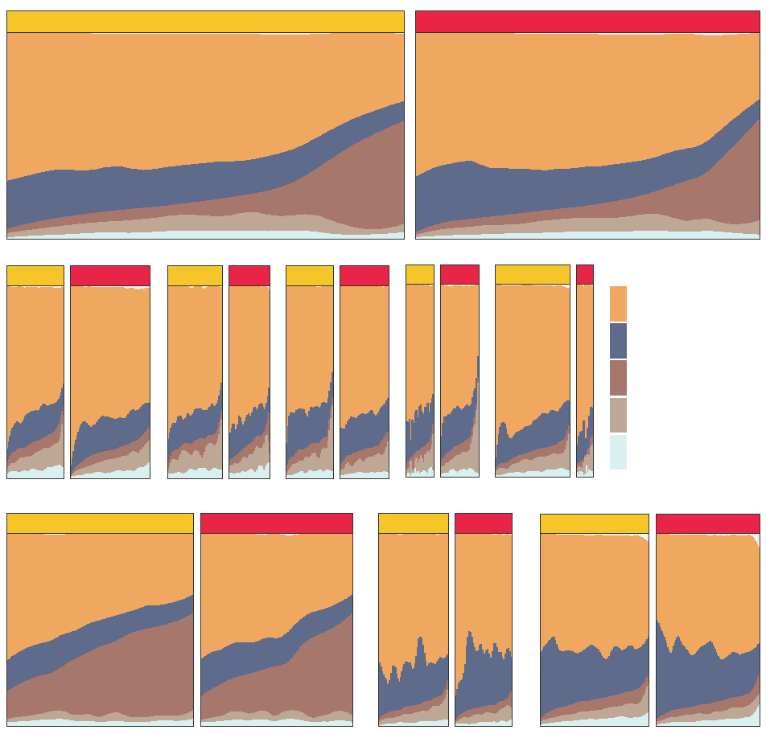
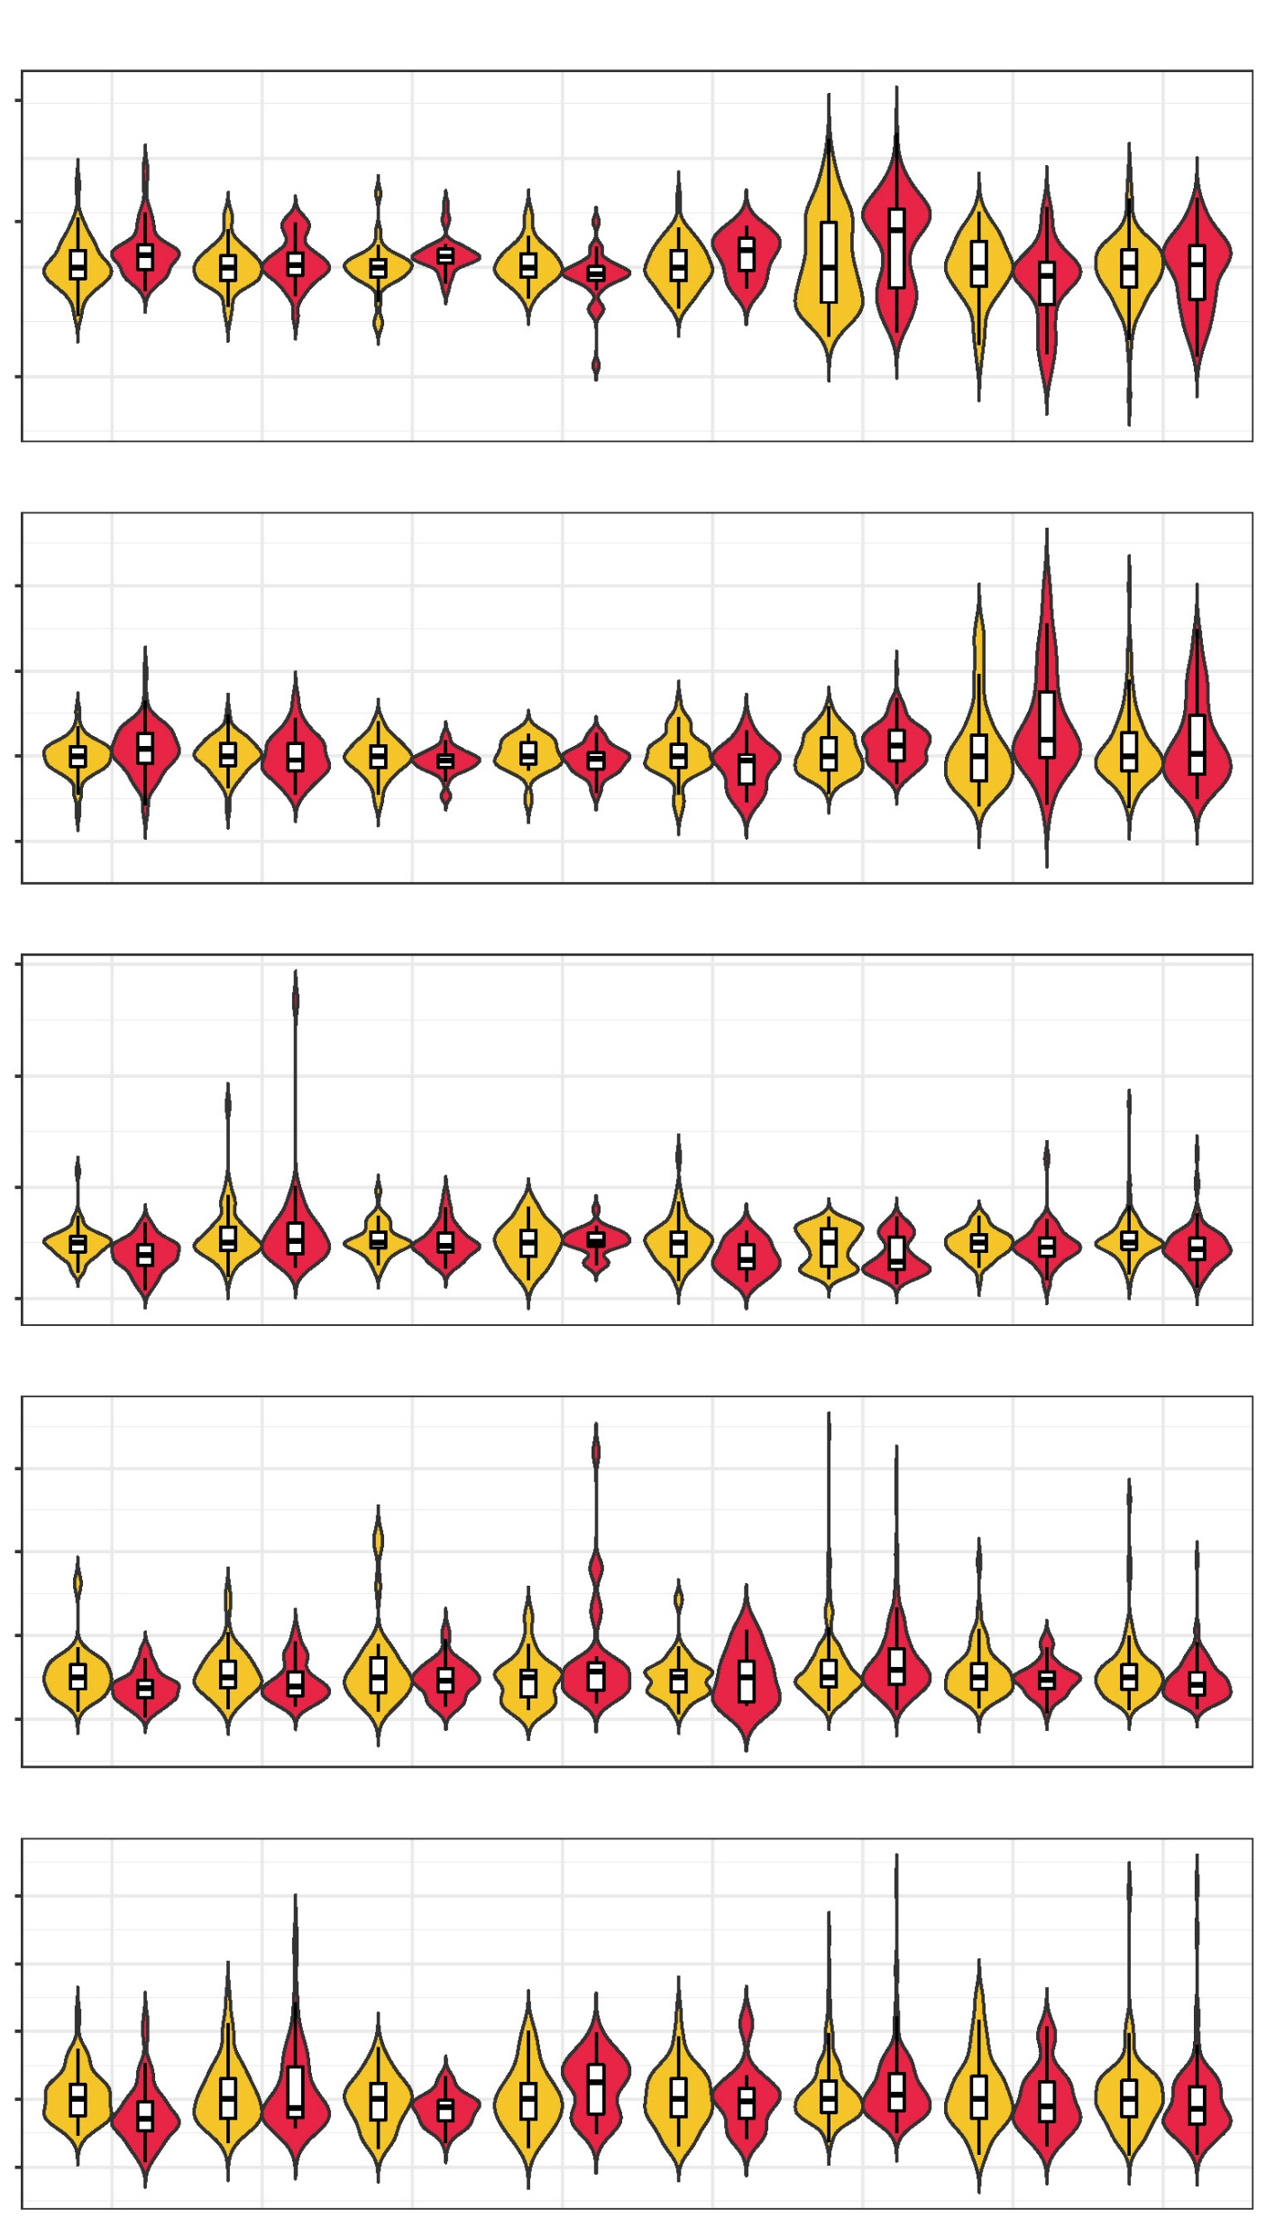
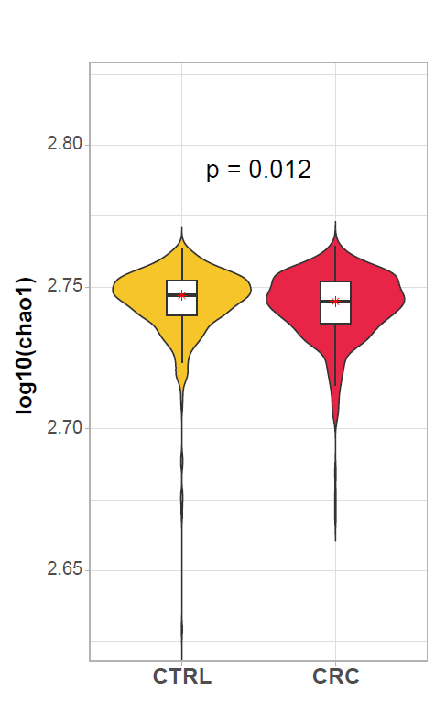
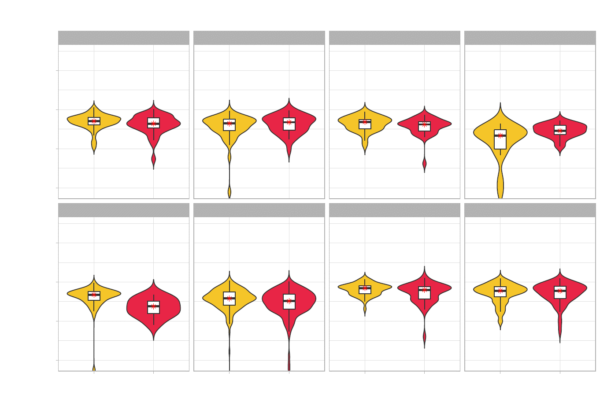
a
c
Ascomycota
2.2e-03
Control
CRC
1.5
6.1e-03
7.5e-04
1.0
0.5
Basidiomycota
6
4.3e-02
2.7e-04
4.8e-03
4
2
b
2014_ZellerG (EU)
2015_FengQ (OC)
2016_VogtmannE (NA)
2019_ThomasAM (EU)
2019_WirbelJ (EU)
0
Mucoromycota
Control
CRC
Control
CRC
Control
CRC
Control
CRC
Control
CRC
CORE PHYLUM
1.6e-04
3.3e-03
Ascomycota
4
2.3e-04
2.2e-02
Basidiomycota
2
Mucoromycota
0
Microsporidia
2.2e-02
Microsporidia
6
8.6e-04
2.2e-02
Chytridiomycota
4
2019_YachidaS (AS)
2017_YuJ (AS)
2021_YuJ (AS)
2
Control
CRC
Control
CRC
Control
CRC
0
Chytridiomycota
4.5e-02
4
8.3e-05
3
2
1
0
2014_ZellerG (EU)
2015_FengQ (OC)
2016_VogtmannE (NA)
2019_ThomasAM (EU)
2019_WirbelJ (EU)
2019_YachidaS (AS)
2017_YuJ (AS)
2021_YuJ (AS)
d
2014_ZellerG (EU)
2015_FengQ (OC)
2016_VogtmannE (NA)
2019_ThomasAM (EU)
2.80
0.014
2.76
2.72
2.68
2019_WirbelJ (EU)
2019_YachidaS (AS)
2017_YuJ (AS)
2021_YuJ (AS)
2.80
0.00038
0.017
2.76
2.72
2.68
CTRL
CRC
CTRL
CRC
CTRL
CRC
CTRL
CRC
S figure 2 Taxonomic distribution of enteric fungi and alteration of its alpha diversity across cohorts. (a) Relative abundance of dominant enteric fungal phyla in healthy control, n=525 and CRCs, n=454. Ascomycota, Basidiomycota, Mucoromycota, Microsporidia, and Chytridiomycota were prevalent in both groups. (b) Relative abundance of dominant enteric fungal phyla in each cohort. (c) Comparison of the fungal difference between healthy control and CRC. (d) Comparison of fungal differences in chao1 index diversity indices between CRC (n = 454) and healthy control (n = 525) among the all and each.

